Slide 1
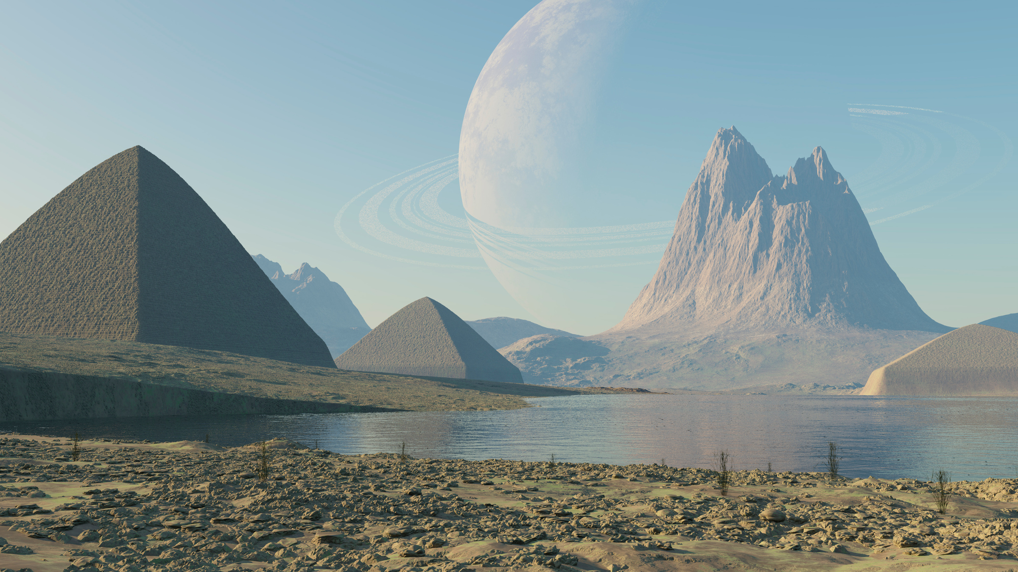
Genre Study
SPECULATIVE fiction
Year 10 English

Slide 2

DEFINITION
The term ‘speculative fiction’ is a broad genre that includes any fiction that deliberately parts from imitating reality and instead focuses on possible futures involving elements like advanced technology, supernatural creatures or fantastical elements.
Speculative fiction often delves into ‘what if’ scenarios, and its wide range of subgenres allows for imaginative exploration beyond the confines of reality.
By pushing the boundaries of the known world, it invites readers to consider new possibilities and reflect on the nature of existence, society, and the human condition.
What it is NOT: literary fiction, romance, crime fiction, etc. It imagines worlds that could be, aren’t, or may never be rather than depicting the world as it already is.

Slide 3
WHY STUDY IT?
ENGAGEMENT & ENJOYMENT
CULTURAL OR SOCIETAL REFLECTION
Speculative fiction is inherently engaging, often featuring thrilling plots, rich world-building, and captivating narratives that can inspire a lifelong love of reading and learning.
The genre often reflects societal concerns, hopes, and fears, serving as a lens through which we examine our own world including social issues and cultural values.
CRITICAL THINKING
SOCIAL COMMENTARY
Speculative fiction frequently presents complex, thought-provoking themes and ethical dilemmas, challenging readers to think critically about technology, morality, and the future.
Authors often use their narratives to comment on social, political, and environmental issues, prompting readers to reflect on real-world problems and consider potential solutions.

Slide 4
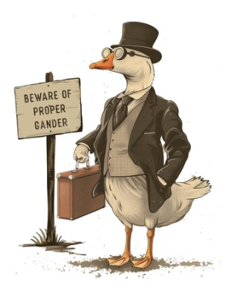
WHY STUDY IT?
*
MEDIA LITERACY
You will learn about other genres too, but speculative fiction covers a wide range of the books, films, TV shows and video games that you will continue to engage with for the rest of your lives.
Knowing how to critically engage with those texts is essential for our personal and collective well-being.
Without media literacy we become susceptible to manipulation and propaganda*, as well as bad at conversation.

Slide 5

SUBGENRES
Speculative fiction offers diverse storytelling possibilities through exploring a range of imaginative and thought-provoking scenarios through many different subgenres.

Slide 6
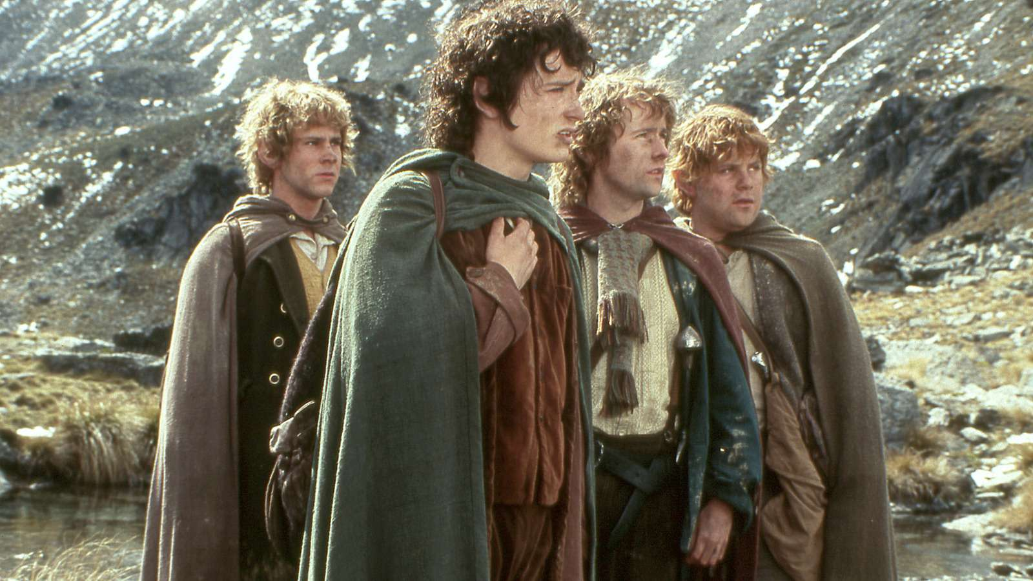
SUBGENRES
FANTASY
High / Epic Fantasy (e.g. The Lord of the Rings)
Low Fantasy (e.g. American Gods)
Sword & Sorcery (e.g. Conan the Barbarian)
Urban Fantasy (e.g. The Dresden Files)
Dark Fantasy (e.g. Interview with the Vampire)
Grimdark (e.g. The Poppy War)
Portal / Crossworlds Fantasy (e.g. The Chronicles of Narnia)
Fairy Tale Retellings (e.g. Uprooted)
Steampunk Fantasy (e.g. Mortal Engines)
Romantasy (e.g. Fourth Wing)
Description: Features magical or supernatural elements set in imaginary worlds or within the real world.
Key Elements: Magic, mythical creatures, epic quests, and world-building.

Slide 7
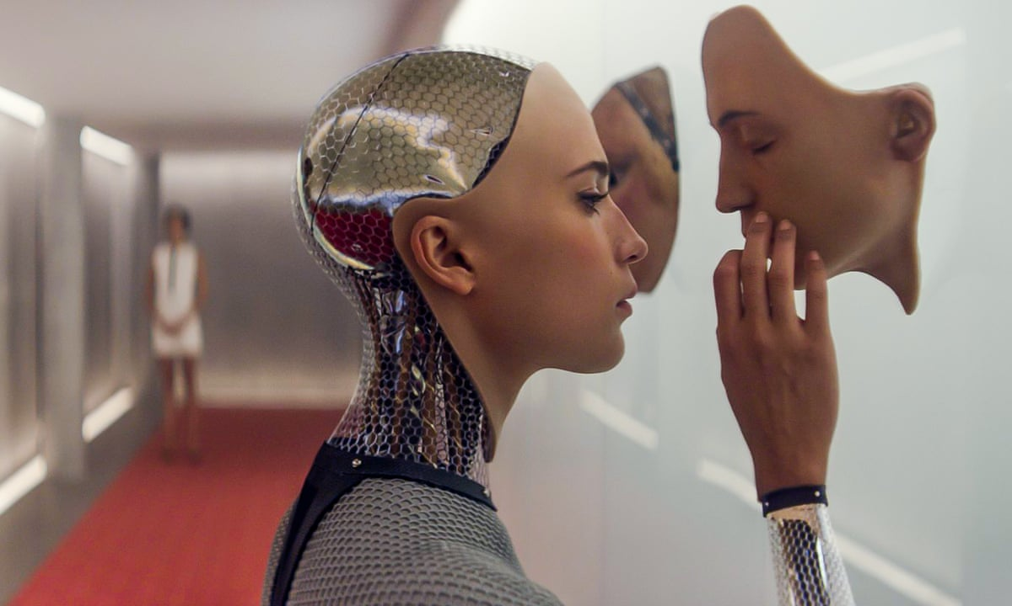
Description: Explores futuristic concepts, advanced technologies, space exploration, time travel, and extraterrestrial life.
Key Elements: Scientific principles, plausible future scenarios, and a reflection on the impact of technology on society.
SUBGENRES
Hard Sci-Fi (e.g. The Martian)
Soft Sci-Fi (e.g. Never Let Me Go)
Space Opera (e.g. Dune)
Cyberpunk (e.g. Neuromancer)
Solarpunk (e.g. A Psalm for the Wild-Built)
Military Sci-Fi (e.g. Starship Troopers)
Time Travel Fiction (e.g. The Time Machine)
Post-Apocalyptic (e.g. The Road)
Climate Fiction (Cli-Fi) (e.g. The Ministry for the Future)
SCIENCE FICTION

Slide 8
DEBATE
Is Star Wars science fiction, or is it a fantasy story with spaceships?
Think. Pair. Share.

Slide 9
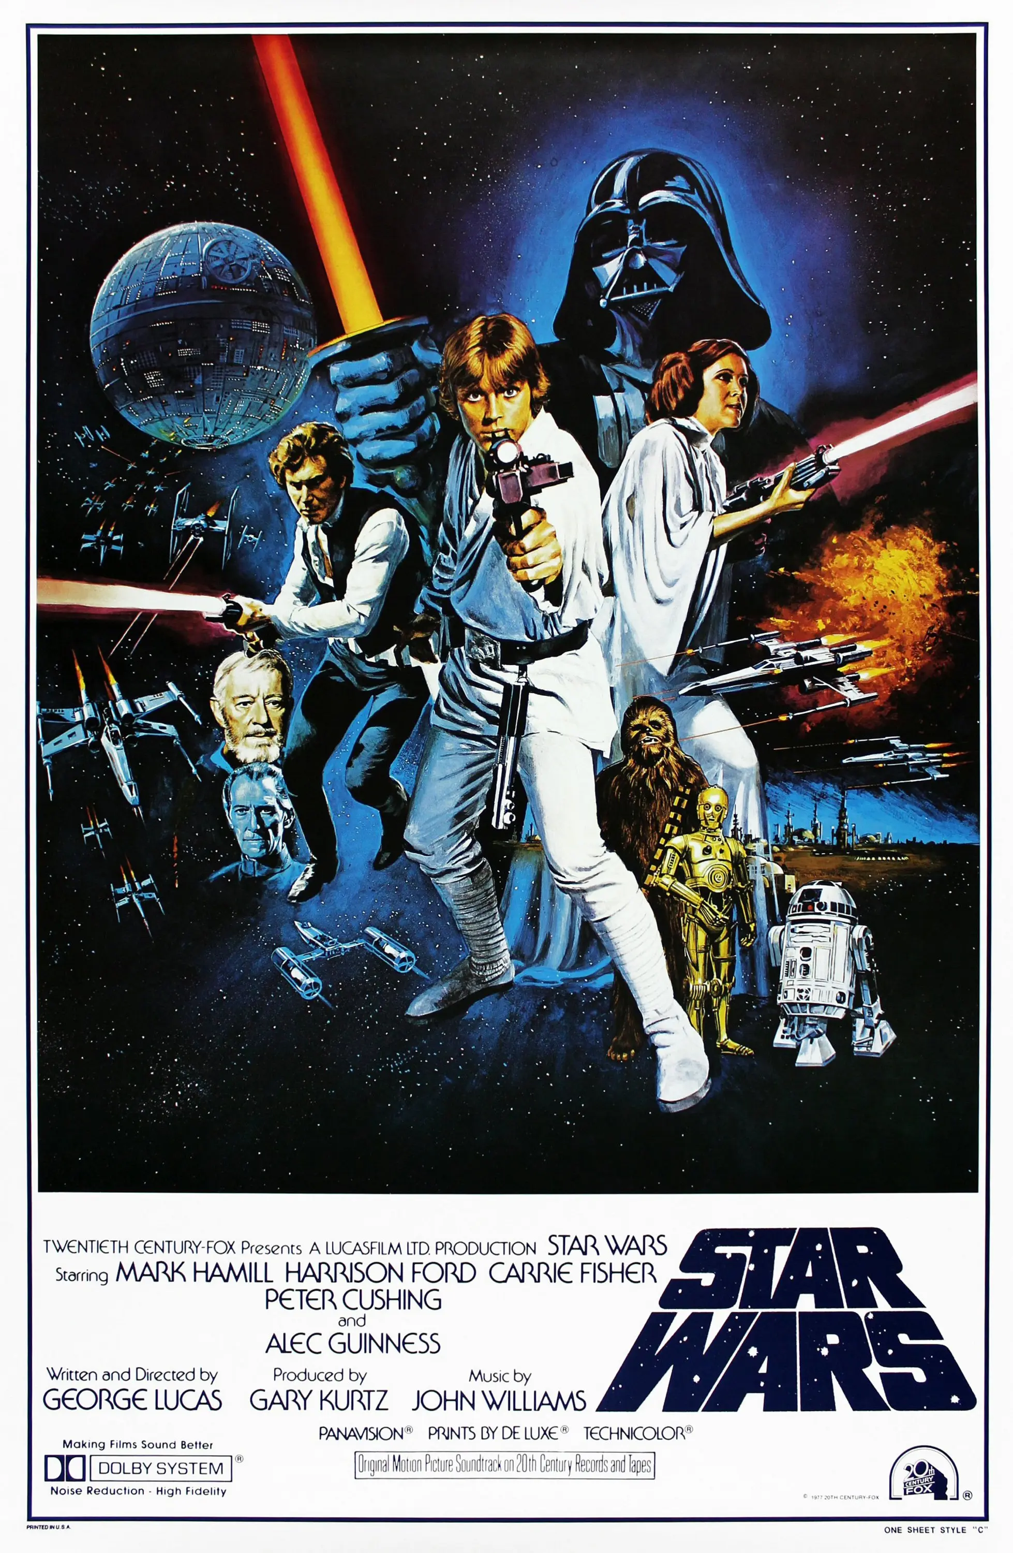
IS STAR WARS SCI-FI?
THE ARGUMENT
Spaceships, droids, laser blasters, faster-than-light travel, alien planets… Star Wars is, at first glance, a classic sci-fi, set ‘in a galaxy far, far away.’
HOWEVER
George Lucas has said Star Wars ‘isn’t a science-fiction film, it’s a fantasy film and a space opera.’ The Force works like magic, the Jedi are sword-wielding wizards, and the story follows myth and fairy-tale patterns, not scientific speculation. So, structurally it sits closer to Tolkien than to hard sci-fi like ‘2001: A Space Odyssey.’

Slide 10
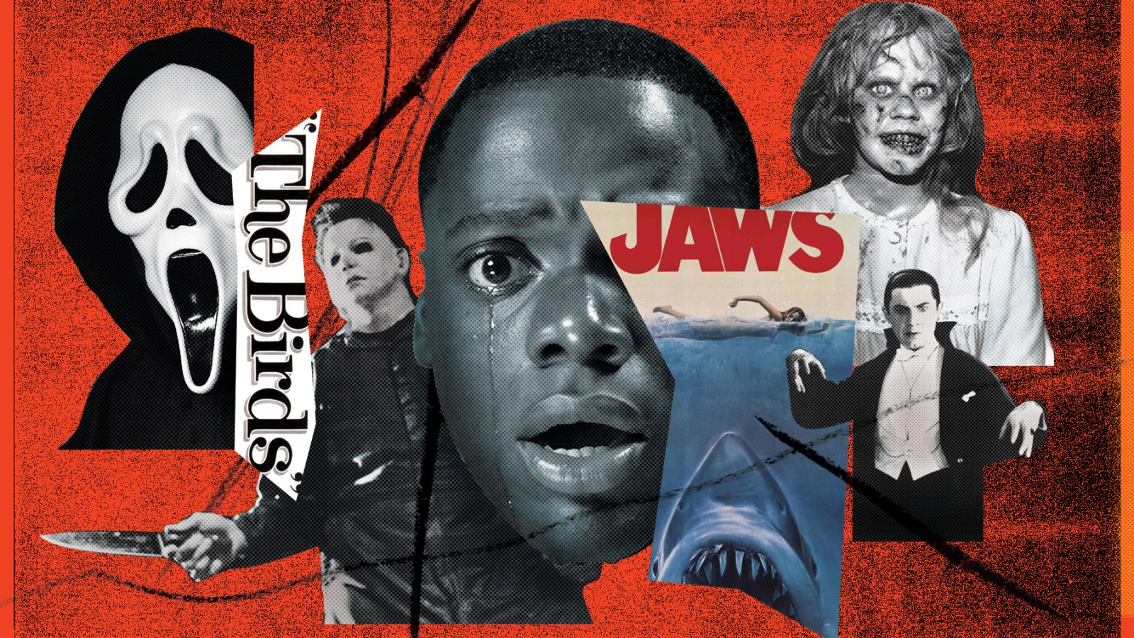

HORROR
SUBGENRES
Gothic Horror (e.g. Dracula)
Psychological Horror (e.g. The Shining)
Slasher (e.g. Halloween)
Cosmic / Lovecraftian (e.g. The Call of Cthulhu)
Body Horror (e.g. The Fly)
Supernatural / Paranormal (e.g. The Exorcist)
Splatterpunk (e.g. Hellraiser)
Folk Horror (e.g. Midsommar)
Found Footage (e.g. The Blair Witch Project)
Comedy Horror (e.g. Shaun of the Dead)
Description: Aims to evoke fear, dread, or shock, often involving supernatural or macabre themes.
Key Elements: Monsters, ghosts, psychological terror, and eerie settings.

Slide 11
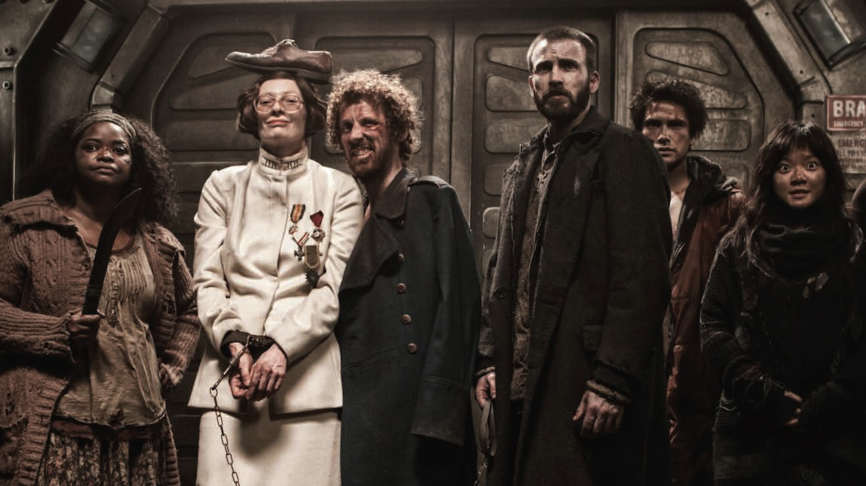
Description: Depicts oppressive societies, often set in the future, where humanity faces significant challenges.
Key Elements: Authoritarian governments, environmental disasters, social decay, and survival themes.
SUBGENRES
Totalitarian / Political (e.g. 1984, Brave New World)
Post-Apocalyptic (e.g. Mad Max, Snowpiercer)
Techno-Dystopia (e.g. Black Mirror, Feed)
Eco-Dystopia (Cli-Fi) (e.g. The Water Knife, MaddAddam)
Feminist Dystopia (e.g. The Handmaid's Tale, The Power)
YA Dystopia (e.g. Divergent, The Maze Runner, The Hunger Games)
Cyberpunk Dystopia (e.g. Blade Runner, Neuromancer)
DYSTOPIAN

Slide 12

Description:
Explores historical events with different outcomes or altered timelines.
Key Elements:
‘What if’ scenarios, historical figures in changed circumstances, and reimagined historical settings.
SUBGENRES
Uchronia (e.g. The Man in the High Castle, Fatherland)
Steampunk Alt-History (e.g. The Difference Engine, Boneshaker)
Secret History (e.g. The Da Vinci Code, Foucault's Pendulum)
Dieselpunk / Atompunk (e.g. Wolfenstein, Sky Captain and the World of Tomorrow)
Counterfactual War Fiction (e.g. Fatherland, The Plot Against America)
Parallel Universe Fiction (e.g. His Dark Materials)
ALTERNATE HISTORY

Slide 13

SUBGENRES
MAGICAL REALISM
Latin American Magical Realism (e.g. One Hundred Years of Solitude, Like Water for Chocolate)
Folkloric Magical Realism (e.g. Beloved, The Tiger's Wife)
Urban Magical Realism (e.g. Before the Coffee Gets Cold)
Postcolonial Magical Realism (e.g. Midnight's Children, The God of Small Things)
Contemporary Literary Magical Realism (e.g. The Night Circus, Life of Pi)
Magical Realist Film (e.g. Pan's Labyrinth, Amélie)
Description:
Blends magical elements with a realistic narrative, treating the extra-ordinary as a natural part of everyday life.
Key Elements:
Subtle magical elements, ordinary settings, and a seamless integration of the fantastical with the mundane.

Slide 14
GENRE, SUBGENRE, CONVENTIONS & TROPES
GENRE | COMMON SUBGENRES | CONVENTIONS | TROPES
SCIENCE FICTION | Dystopian • cyberpunk • space opera | Technology/science shapes the world; speculative “what if?”; social consequences | AI rebellion • time travel • alien invasion • megacorporation
FANTASY | High • urban • dark • epic fantasy | Magic or supernatural rules; invented worlds/cultures; quests or conflicts | Chosen one • prophecy • magical artefact • dark lord • mentor
HORROR | Gothic • supernatural • psychological • body horror | Fear/dread; threatening atmosphere; vulnerability; the unknown or uncanny | Haunted house • possession • monster • final survivor • cursed object
DYSTOPIAN | Political • eco-dystopia • techno-dystopia | Oppressive society; restricted freedom; critique of power; resistance | Surveillance state • forbidden knowledge • rebellion • controlled population
ROMANTASY | Fantasy romance • romantic fantasy • dark romantasy | Fantasy world + major romantic arc; magic/high stakes; romance drives or shares the plot | Enemies to lovers • fated mates • morally grey love interest • fae courts • forbidden love • only one bed • touch her and die • secret royal heir • slow burn

Slide 15
ROMANTASY + BOOKTOK
WHY SO BIG NOW?
BookTok has amplified discoverability and word-of-mouth. UK science-fiction/fantasy sales value rose 41.3% in 2024, with romantasy helping drive the surge.
WHY CAN IT FEEL FORMULAIC?(Because it is)
The same highly marketable trope combinations recur: enemies-to-lovers, fated mates, “morally grey” heroes, fae courts and trials. Predictability can be part of the appeal, but repetition can also make texts feel interchangeable.

Slide 16
PLOT & STRUCTURAL ELEMENTS
NON-LINEAR NARRATIVES
MULTIPLE PERSPECTIVES
QUEST & ADVENTURE
CONFLICT & RESOLUTION
Use of non-linear storytelling, including flashbacks, time travel, and fragmented timelines.
Frequent conflicts such as human vs. technology, good vs. evil, or individual vs. society.
Incorporation of various viewpoints to provide different angles on the story.
Central narratives often revolve around epic quests, journeys, or adventures.

Slide 17
THEMES & MOTIFS
EXPLORATION AND DISCOVERY
TECHNOLOGY AND THE FUTURE
Characters venture into unknown realms or discover hidden aspects of their own world, pushing the boundaries of knowledge and experience.
Imagining future societies shaped by advanced technology and scientific progress, often exploring the impact
on humanity.
HUMANITY AND IDENTITY
SOCIAL AND POLITICAL COMMENTARY
Questions about what it means to be human, including explorations of identity, consciousness, and the soul.
Critiques of societal norms, government systems, and cultural practices, often through allegory or satire.

Slide 18
INDIVIDUAL RESEARCH TASK
  Look up your favourite SPECULATIVE FICTION book, short-story, film, TV show or videogame.
  Find out what genre/subgenre it is.
  Identify its conventions, tropes and characteristics and how your chosen text uses them.
  Research the historical context during which it started.
  Collect the information into a single slide and share to Google Classroom.

Slide 19
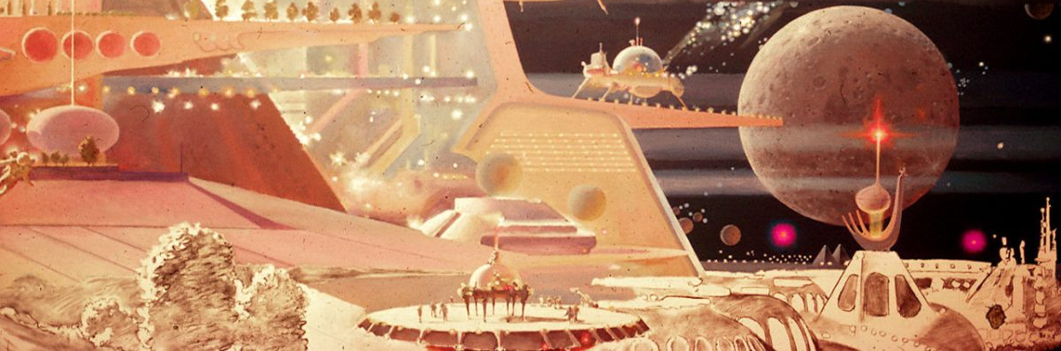
TO WRAP UP
Speculative fiction plays a vital role in literature by encouraging imagination, exploring endless possibilities, and providing a platform to critique societal norms. It challenges readers to envision different realities and question the status quo, making it a powerful genre for both entertainment and reflection.

