Slide 1
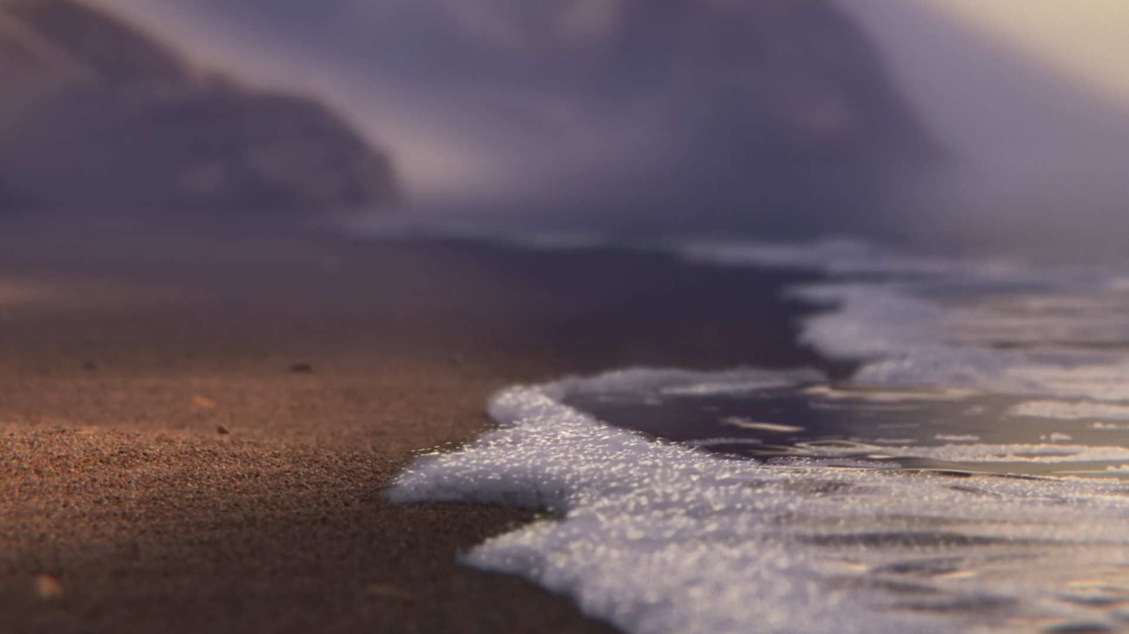
PIPER
How animated films tell stories visually
VISUAL LITERACY • YEAR 8
Today we’ll learn to:
• identify different camera shots and angles
• spot animated film devices such as body language, expression, lighting and pace
• explain how visual choices create meaning and affect the audience

Slide 2
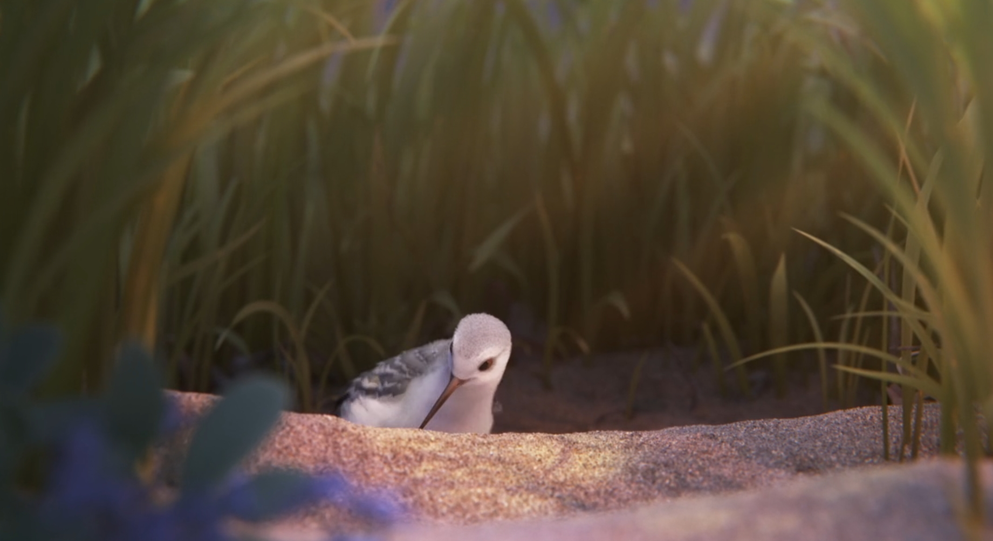
1
LONG SHOT
FRAMING
EFFECT: The long shot gives us a full view of Piper’s small world. The framing of the reeds creates a cosy and safe atmosphere.

Slide 3
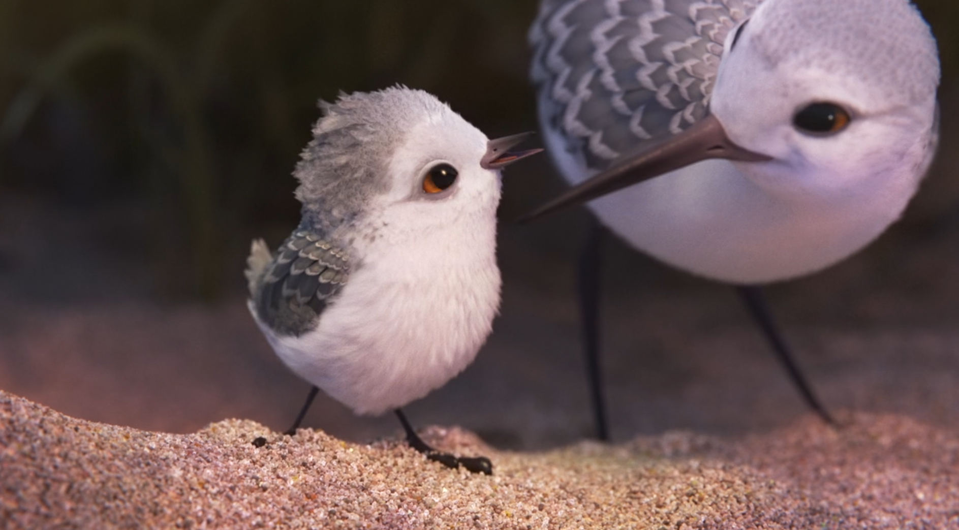
2
MEDIUM FULL TWO SHOT
CHARACTER INTERACTION
EFFECT: The medium close-up keeps Piper and her mother together in the frame. Their closeness shows Piper’s sense of safety and her dependence on her mum.

Slide 4
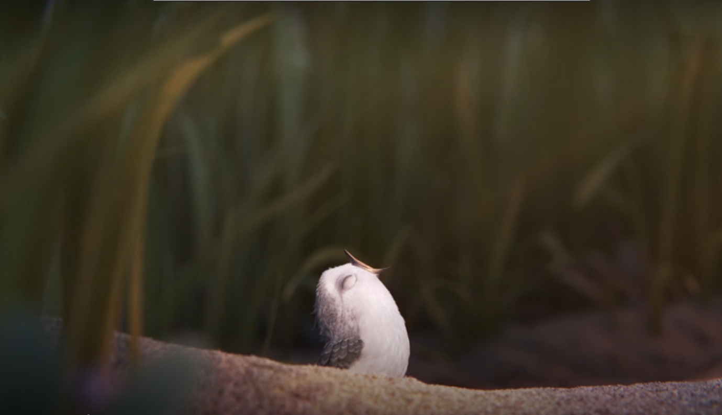
3
MEDIUM-LONG SHOT
BODY LANGUAGE + EXAGGERATED EXPRESSION
EFFECT: Piper waits with her eyes closed and beak wide open, expecting her mum to bring her food. Her exaggerated body language shows her dependence and creates visual humour.

Slide 5
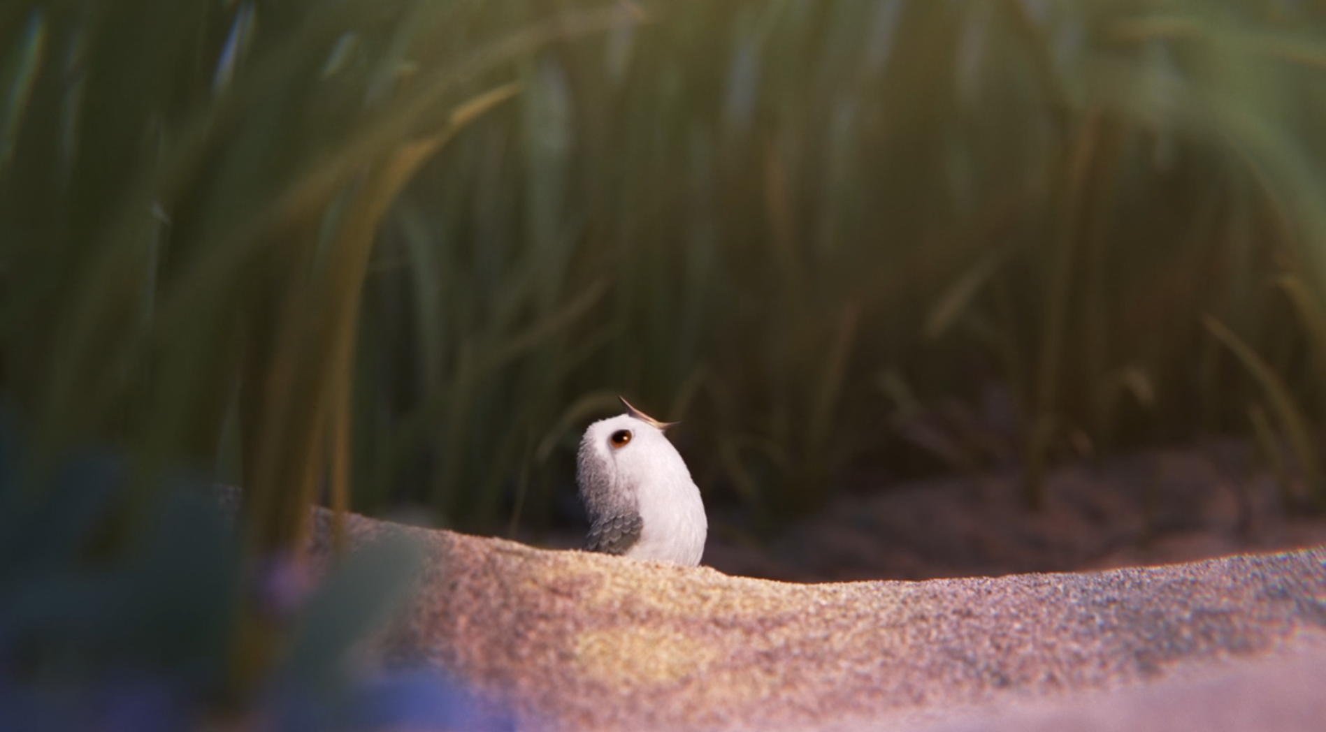
4
MEDIUM-LONG SHOT
FACIAL EXPRESSION + COMEDIC TIMING
EFFECT: Piper opens one eye when the food does not arrive. Her reaction uses comedic timing to show confusion and impatience without dialogue.

Slide 6
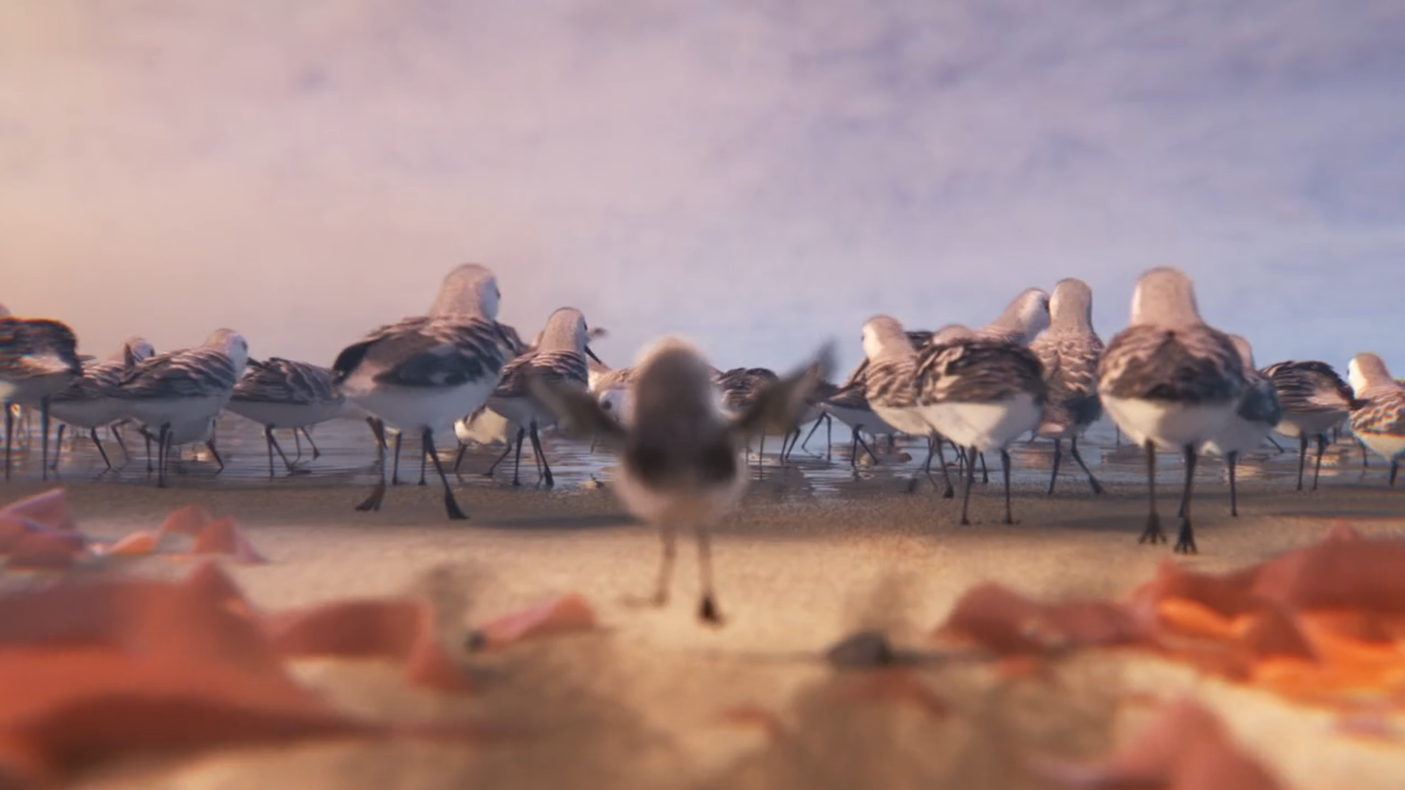
5
WIDE-LONG SHOT
LOW ANGLE + DEPTH OF FIELD
EFFECT: The wide-long shot shows the other birds finding food when Piper tries to join them for the first time. The depth of field separates Piper from the others and keeps our eyes on the right subject.

Slide 7
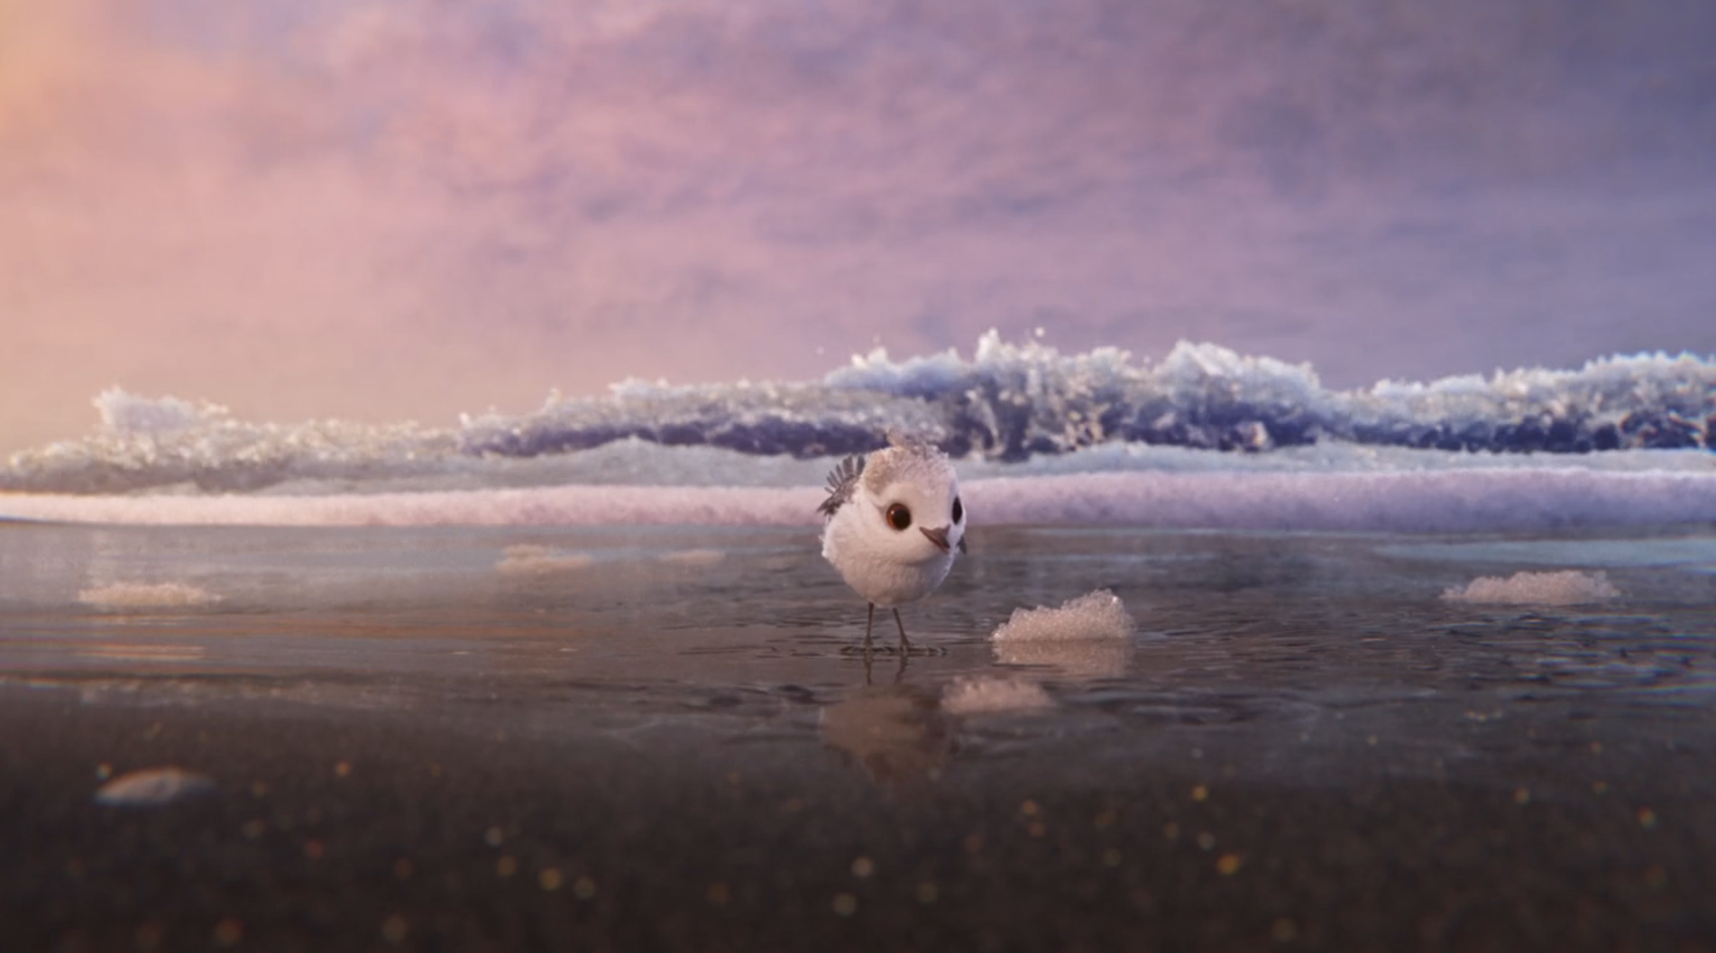
6
WIDE-LONG SHOT
LOW EYE-LEVEL PERSPECTIVE
EFFECT: The low eye-level perspective puts us in Piper’s POV, making the wave in the background seem larger and scarier, establishing the ocean as the challenge she must face.

Slide 8
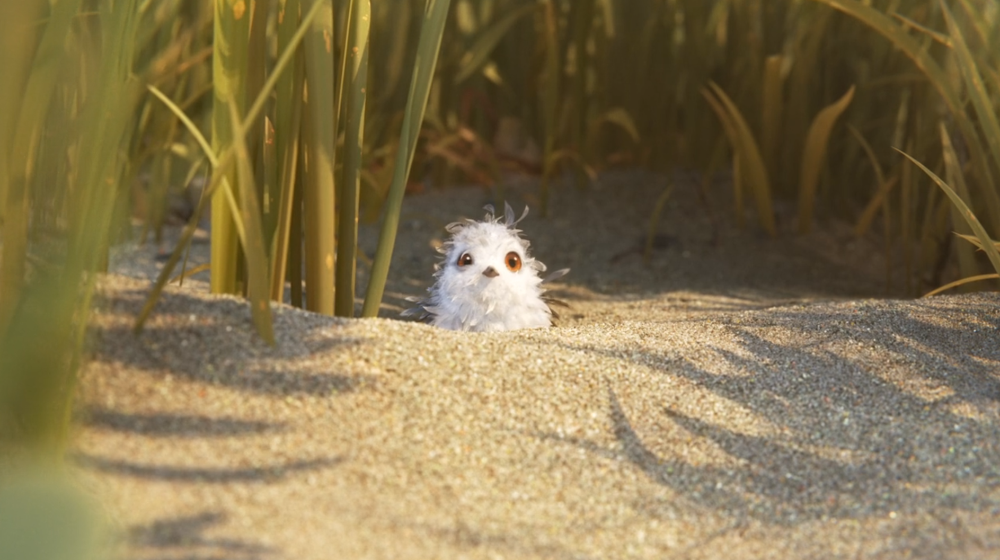
7
MEDIUM-LONG SHOT
BODY LANGUAGE + SETTING
EFFECT: Piper’s shivering and ruffled feathers communicate everything we need to know about her feelings. She’s back in her nest between the reeds, showing that she sought safety in the familiar.

Slide 9
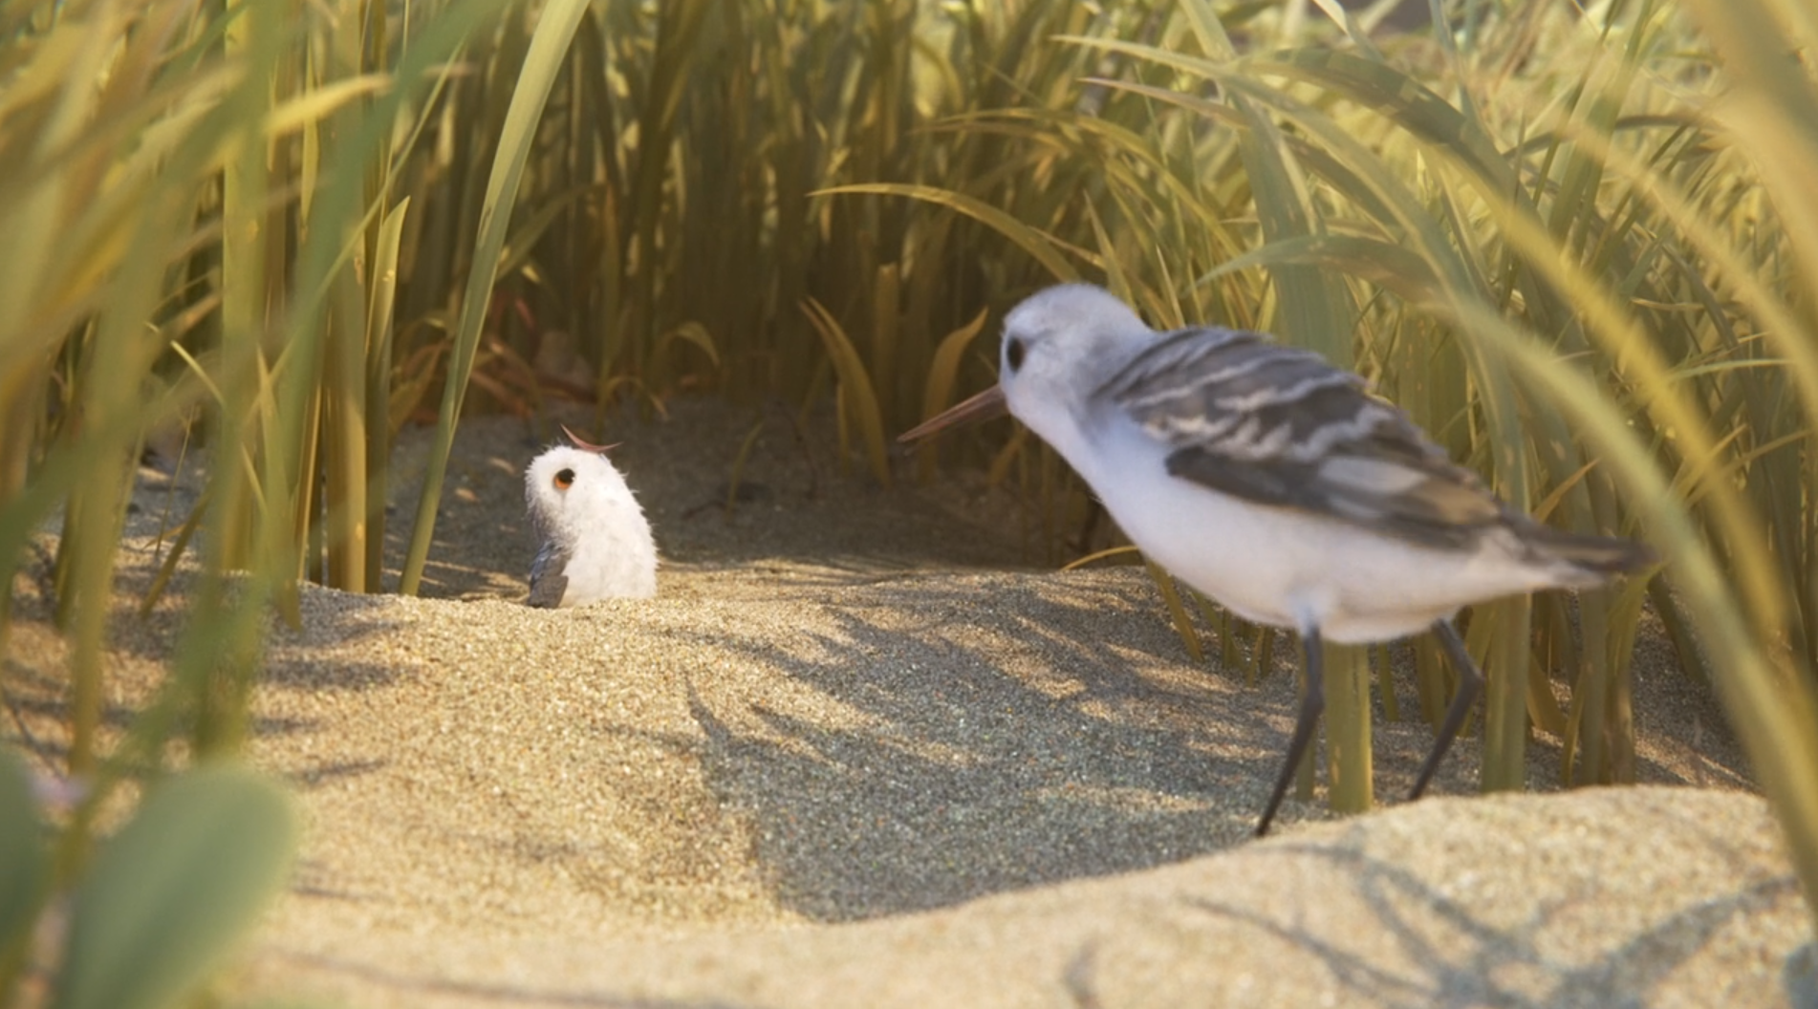
8
LONG TWO-SHOT
CHARACTER INTERACTION
EFFECT: The two-shot shows Piper once again asking her mum to feed her. The mum is slightly outside the nest, showing hesitation, whereas Piper is firmly in her spot. She’s making a firm demand.

Slide 10
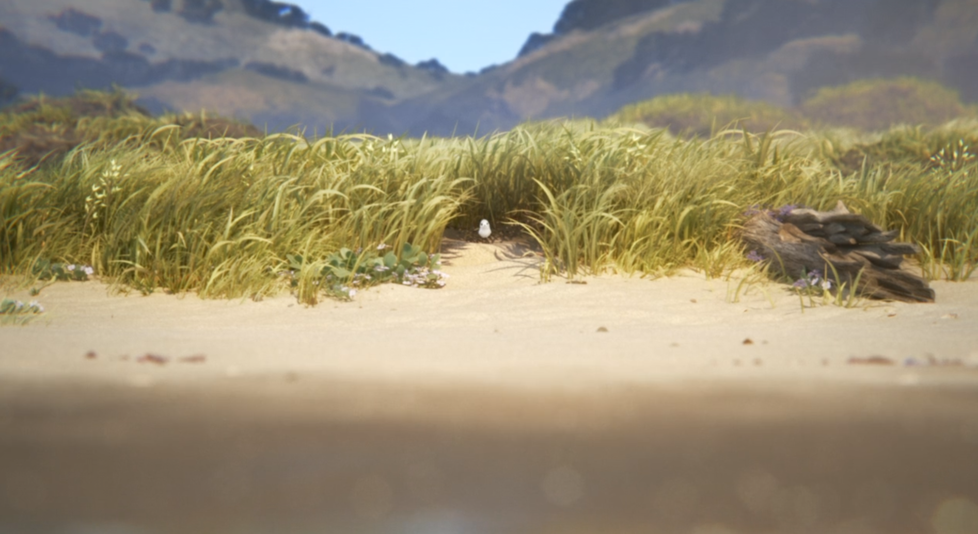
9
EXTREME LONG SHOT
ESTABLISHING SHOT
EFFECT: The extreme long shot makes the distance from the nest to the water seem huge. Piper’s tiny frame amidst the reeds show her vulnerability. The waterline takes almost half of the screen.

Slide 11
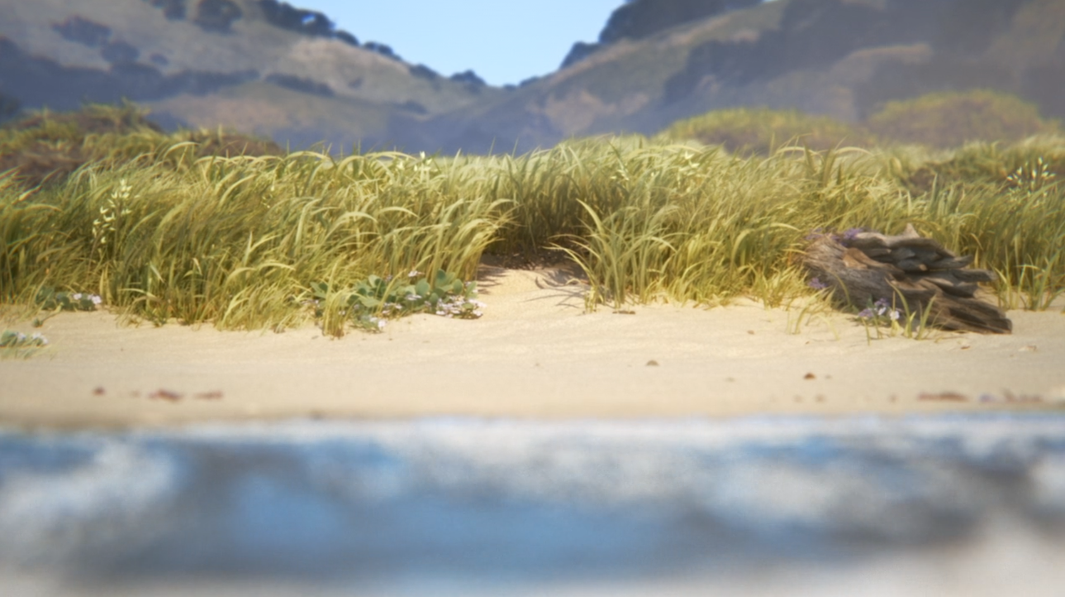
9
EXTREME LONG SHOT
ESTABLISHING SHOT
EFFECT: Piper jumps and hides in the reeds as the water enters and takes up almost half the frame. This shows the danger and fear that Piper must overcome.

Slide 12
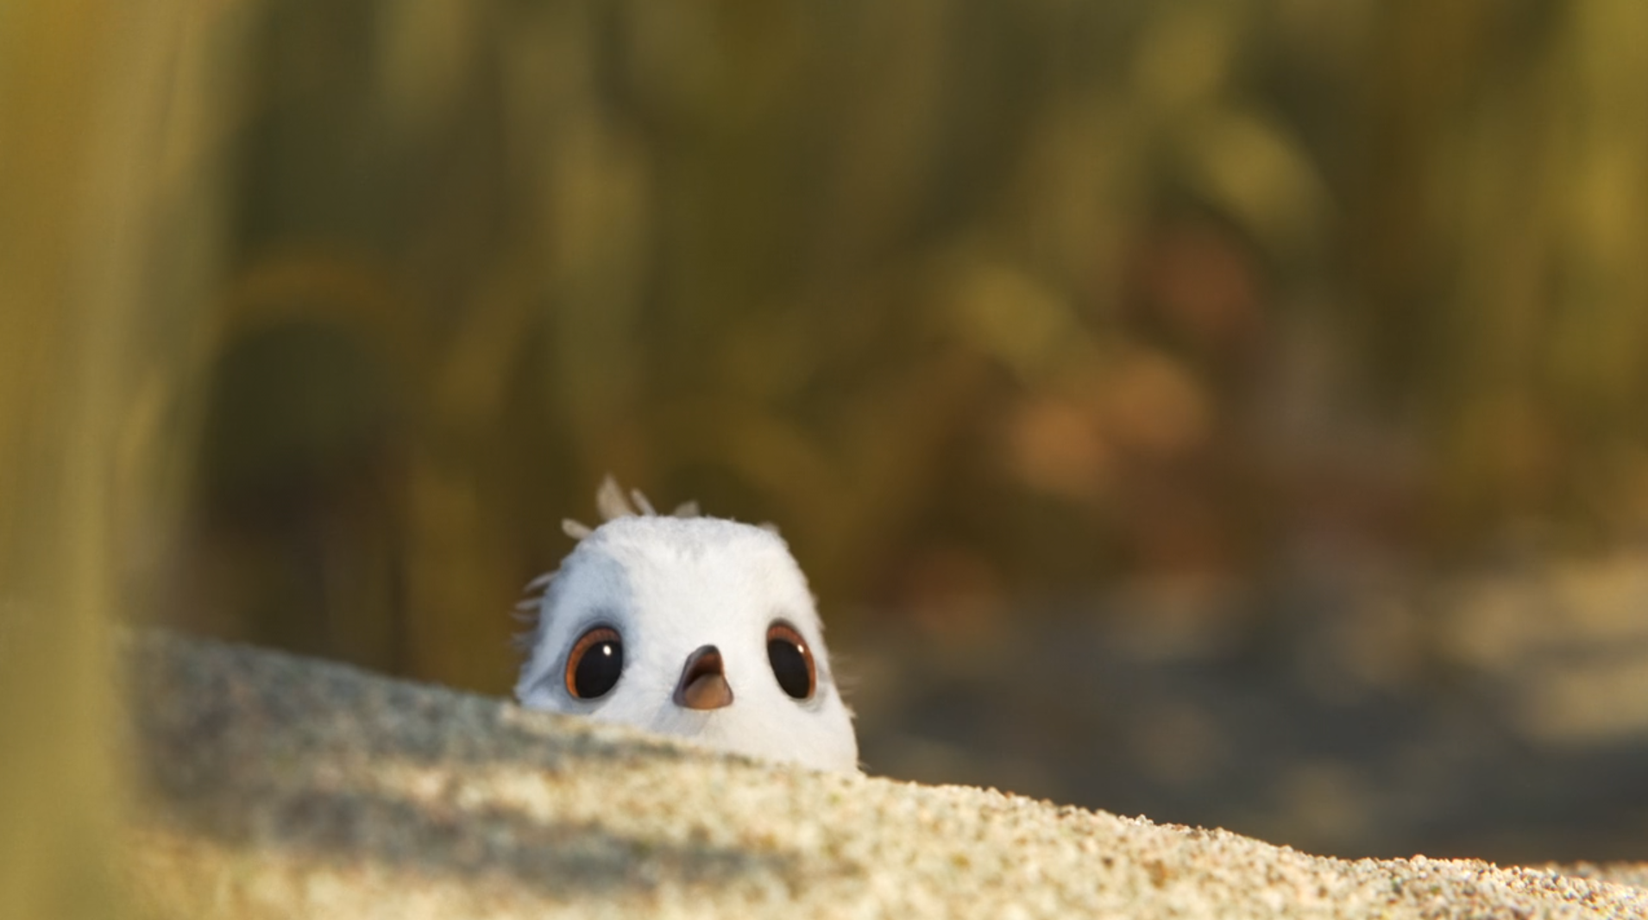
10
MEDIUM CLOSE-UP
FACIAL EXPRESSION
EFFECT: The medium close-up draws our attention to Piper’s expression. She’s hiding behind a small sand dune. We don’t need dialogue to know what she’s feeling.

Slide 13
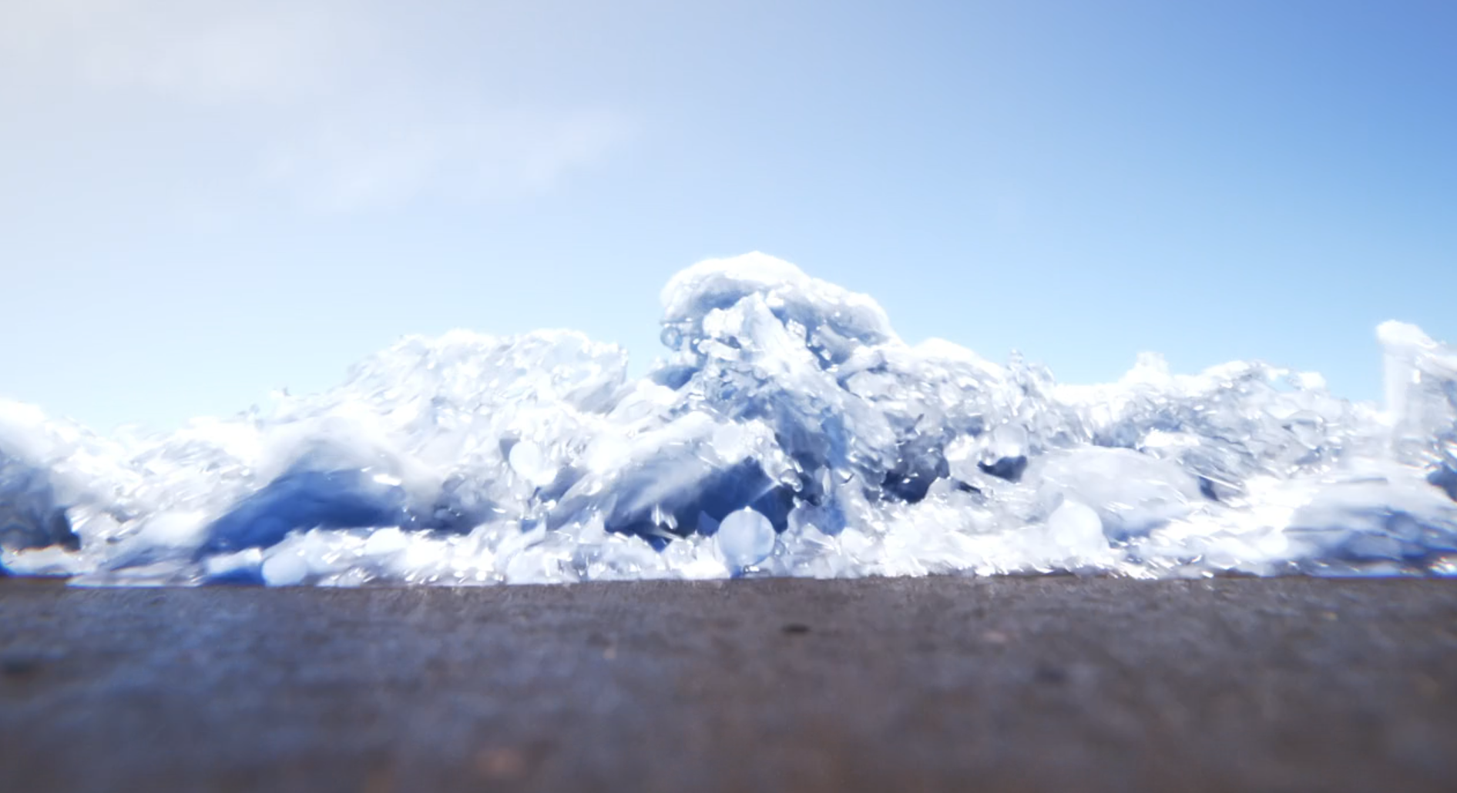
11
MEDIUM CLOSE-UP
LOW ANGLE
EFFECT: The low angle and medium-close up mimic what it’d be like to see the waves from Piper’s perspective.

Slide 14
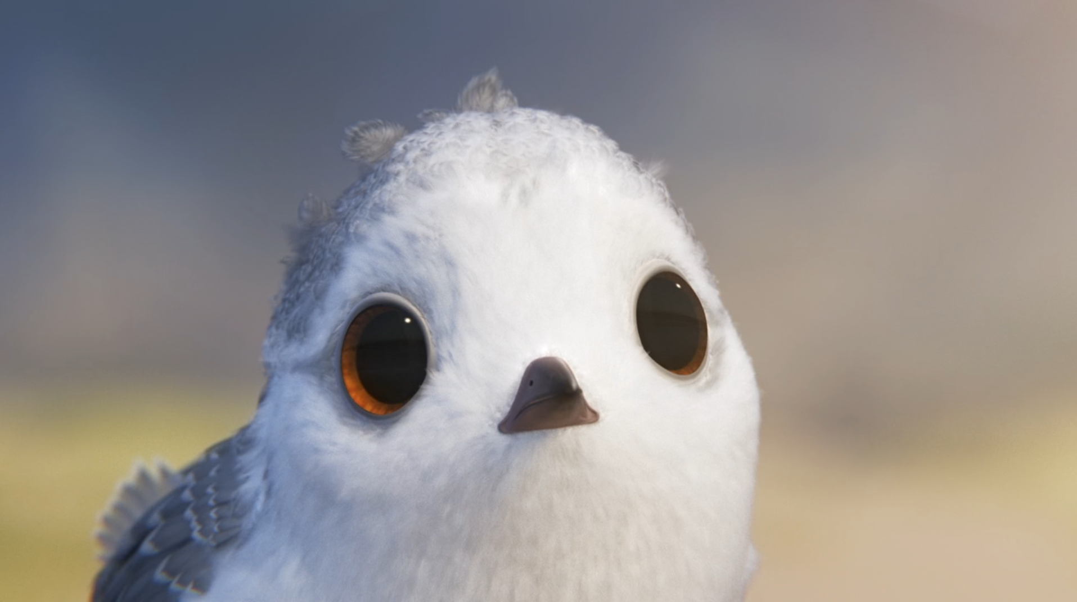
12
CLOSE-UP
FACIAL EXPRESSION
EFFECT: The close-up fills the frame with Piper’s face. Ther wide eyes show us she’s noticing something, making us wonder what it is. Notice the feathers on the top of her head.

Slide 15
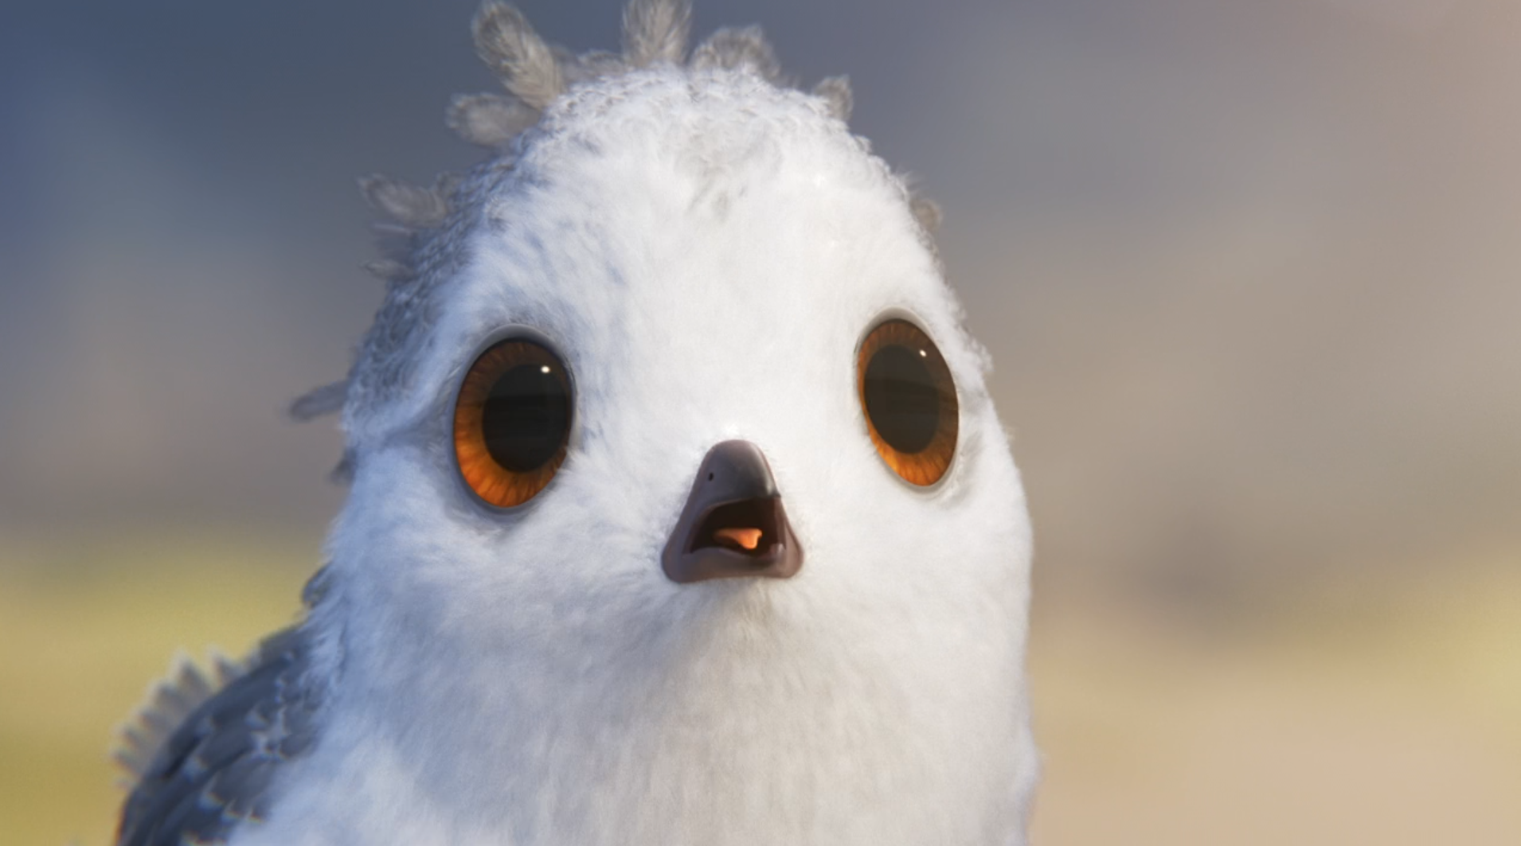
13
CLOSE-UP
EXAGGERATED EXPRESSION
EFFECT: Piper’s wide eyes and open beak exaggerate her shocked reaction. The feathers on her head are now sticking up, showing a full-body panic response. What is she seeing?

Slide 16
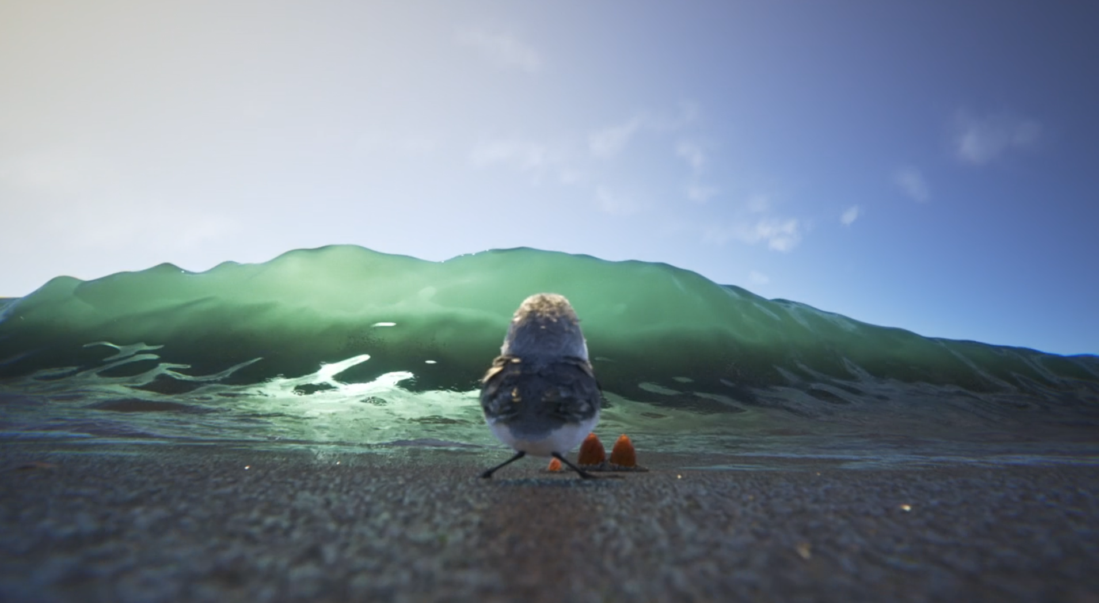
14
MEDIUM-LONG SHOT
SCALE CONTRAST WITH LOW ANGLE
EFFECT: The long shot juxtaposes tiny Piper against the wave. This is an example of how a low angle can make a character appear small and frightened instead of powerful.

Slide 17
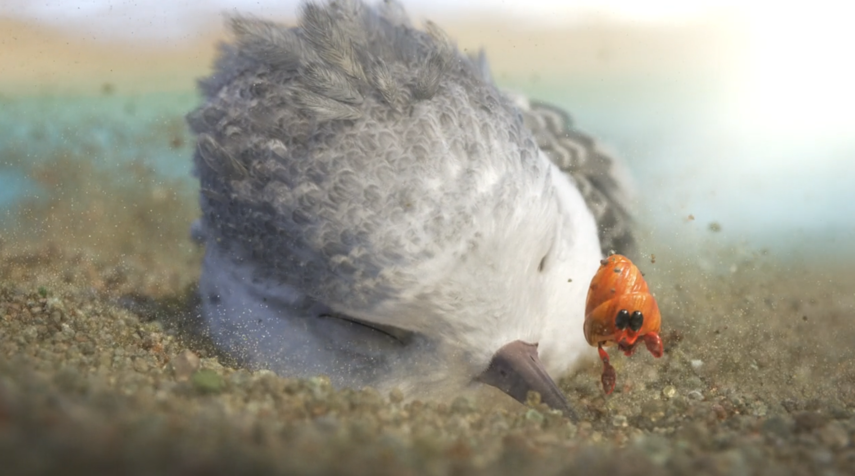

15
CLOSE-UP
VISUAL FOCUS
EFFECT: The close-up puts Piper and the hermit crab together. She hasn’t seen what he has yet, and neither have we as an audience. Just like Piper, we’re waiting to see the ocean from the crab’s perspective.

Slide 18
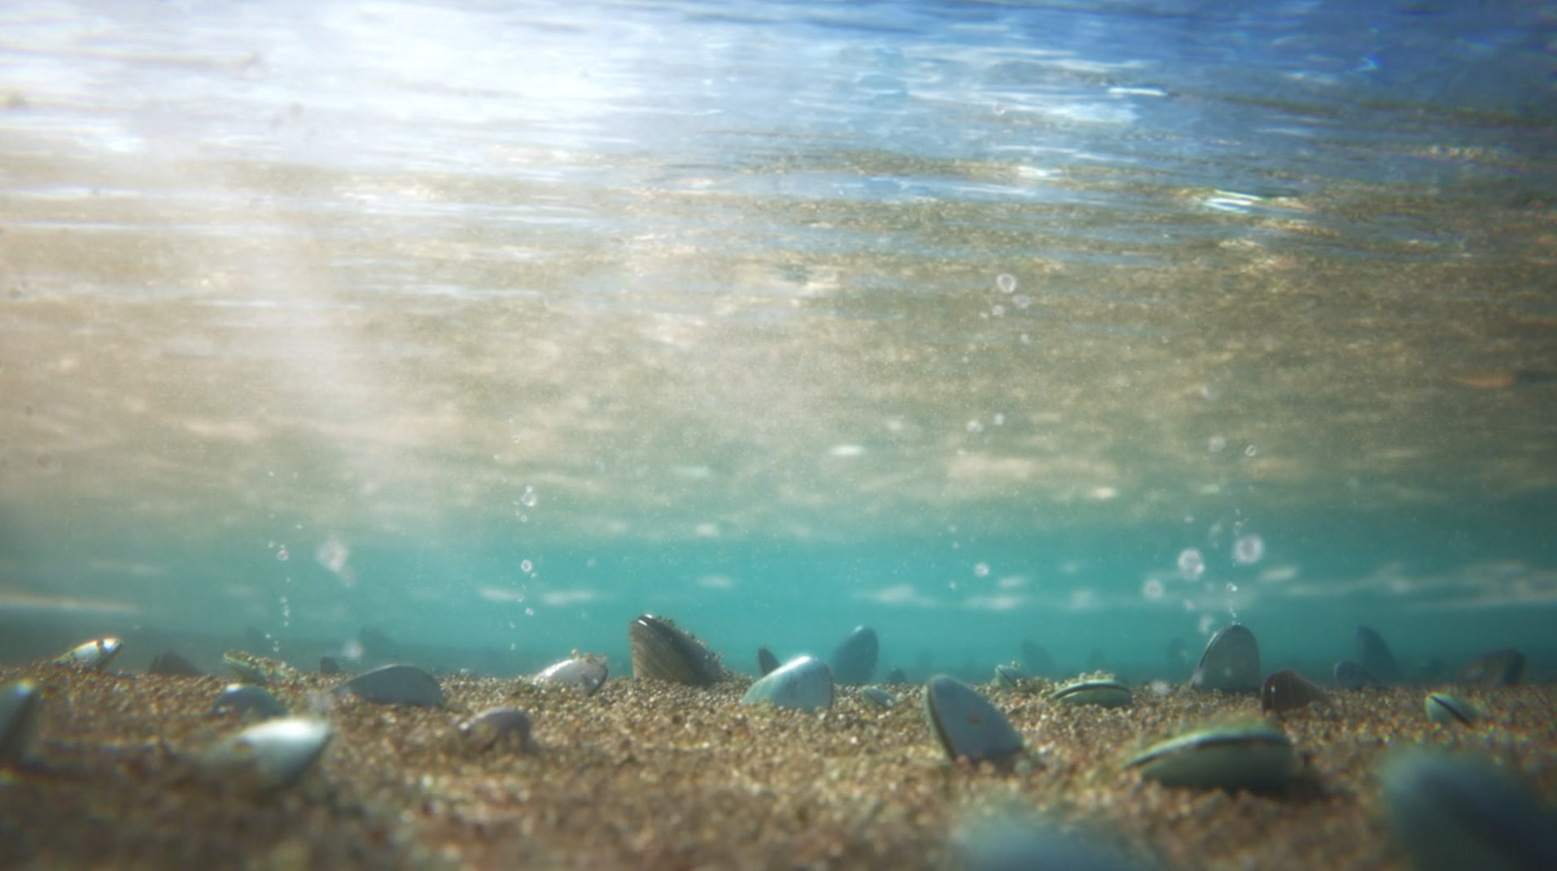
16
MEDIUM LONG SHOT
UNDERWATER PERSPECTIVE
EFFECT: This shot is filmed in a slight slow-motion to transmit serenity. It’s a medium long shot because it’s supposed to be Piper’s POV.

Slide 19
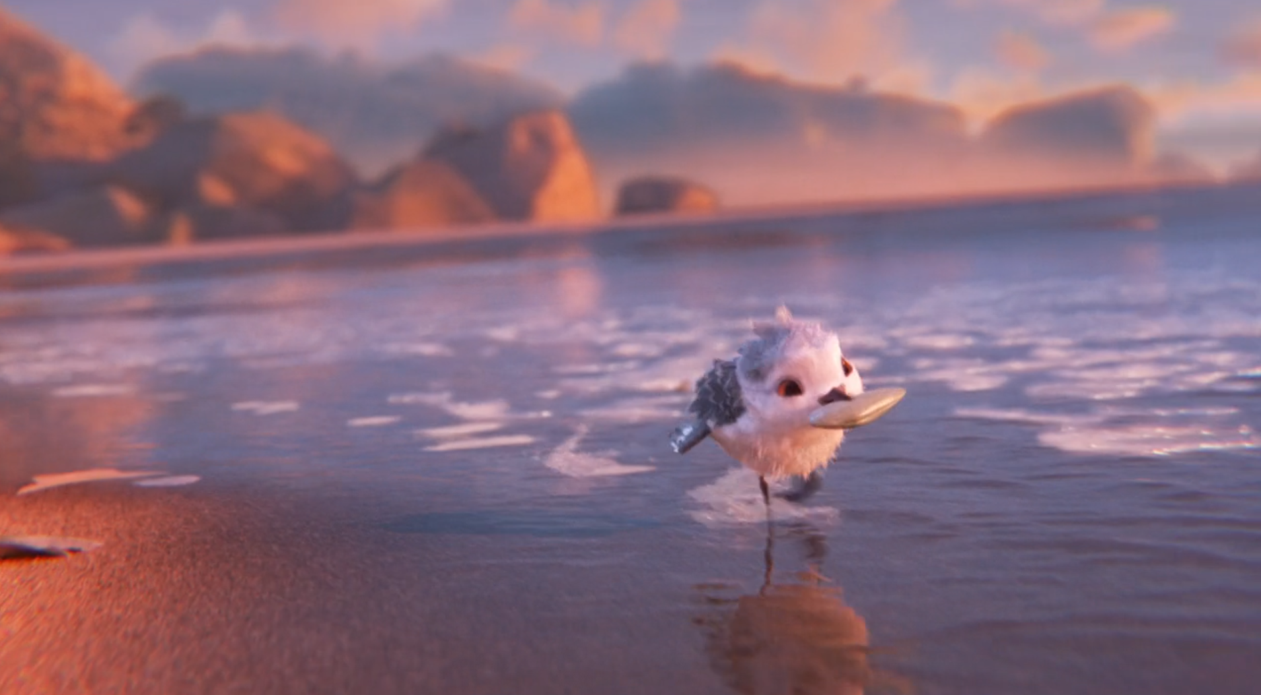
17
LONG SHOT
LIGHTING + BODY LANGUAGE + ENERGETIC PACE
EFFECT: Warm lighting and energetic body language + camera movements create a positive mood. We see the whole beach behind her now because her world has expanded.

