Slide 1

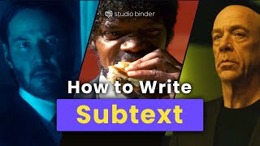
Subtext in film

Slide 2

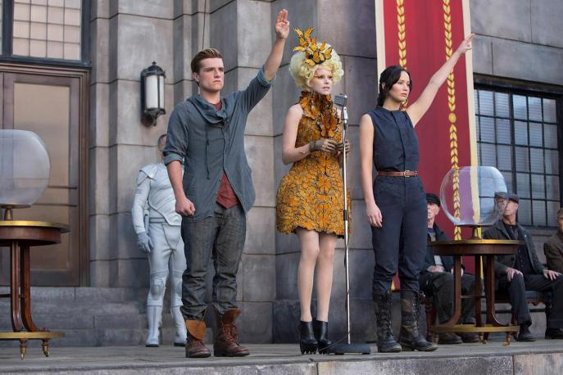
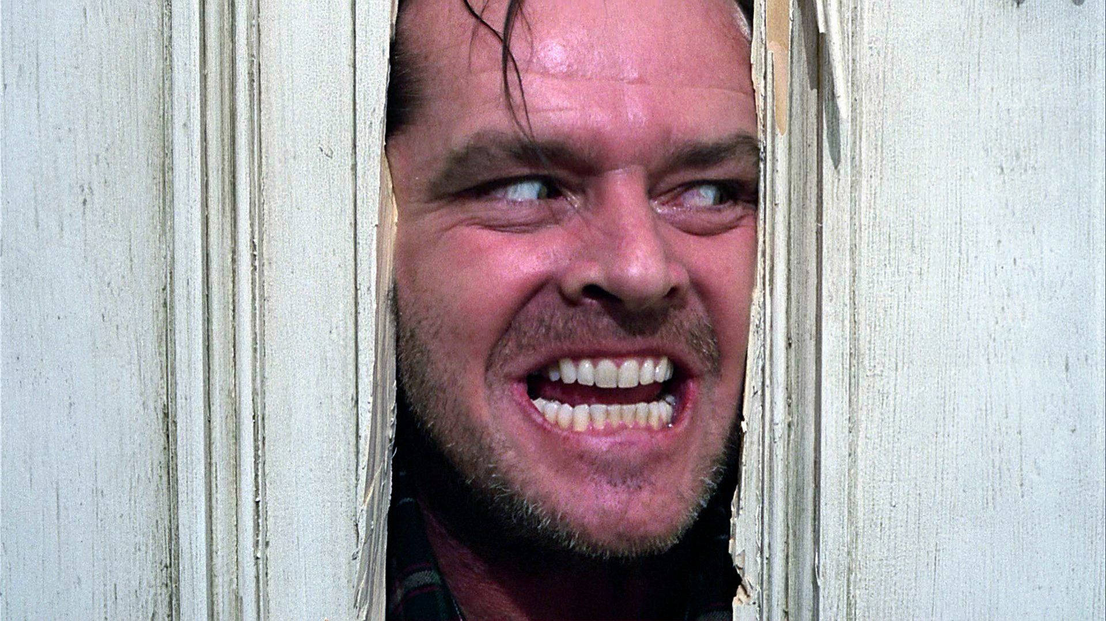
HOW TO WRITE SUBTEXT IN FILM & TV
we’re*
Dialogue
Action lines /
Performance
Structure & Themes
Characters rarely say exactly what they mean. Subtext in dialogue is found in the gap between what is spoken and the character’s true intention or feelings, sometimes manifesting as internal conflict or power play.
Visual motifs and structural irony reinforce hidden messages. This includes social commentary using metaphors to critique real-world issues through narrative.
Meaning is conveyed through what characters do (or don’t do) rather than say. Performance is how the actors and director interpret the action lines on a script (or fill in their absence).

Slide 3

BURNING: A METAPHOR FOR DESTRUCTION
Burning (2019)
In Lee Chang-dong's Burning, Ben is a rich, young man who kills and disposes of women who he deems to be “useless” or “invisible”. He refers to this practice as “burning greenhouses” (or warehouses depending on the translation).
The film explores themes of class, gender dynamics in modern-day South Korea and alienation.

Slide 4
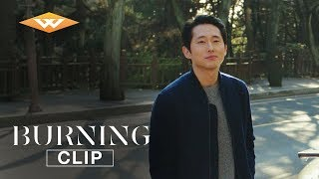
BURNING: A METAPHOR FOR DESTRUCTION CONTEMPT
Subtext & Ambiguity
Subtext is being used here in different ways and for different purposes. Can you identify some of them?
Who seems to hold the power in this dynamic, Ben or Yoo?

